Slide 1

Azure Cosmos DB
Fast NoSQL database with open APIs for any scale

Slide 2
Agenda
Introduction
Resources and Throughput
Querying
Modeling
Using the SQL API

Slide 3
Resource Model
Account
Database
Database
Database
Database
Database
Container
Leveraging Azure Cosmos DB to automatically scale your data across the globe
Database
Database
Item
Notes:
Each resource is uniquely identified by a stable and logical URI and represented as a JSON document
The overall resource model of an application using Azure Cosmos DB is a hierarchical overlay of the resources rooted under the database account, and can be navigated using hyperlinks
Except for the item resource, which is used to represent arbitrary user defined JSON content, all other resources have a system-defined schema
Container and item resources are further projected as reified resource types for a specific type of API interface
For example, while using document-oriented APIs, container and item resources are projected as collection (container) and document (item) resources

Slide 4
Resource Model - Account URI and Credentials
Account
https://{account}.documents.azure.com/
Database
IGeAvVUp …
Database
Database
Database
Database
Container
Database
Database
Item
Notes:
A tenant of the Cosmos DB service starts by provisioning a database account
Accounts are the fundamental units of distribution and high availability
At the account level, you can configure the region[s] for your data in Azure Cosmos DB SQL API
Accounts also contain the globally unique DNS name used for API requests
You can also set the default consistency level for requests at the account
You can manage or create accounts using the Azure portal, Azure Resource Manager templates, the Azure CLI, or Azure PowerShell.
A database account manages one or more databases
Entities under the tenant’s database account – databases, users, permissions, containers etc. are referred to as resources

Slide 5
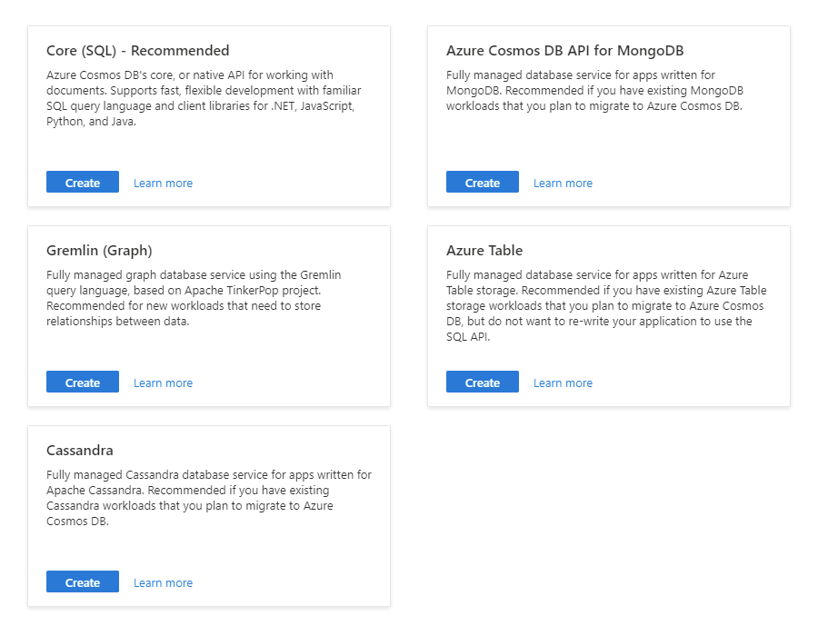

Resource Model - Account API Choice
Account
Database
Database
Database
Database
Database
Container
Database
Database
Item
Notes:
When creating a new account in the portal, you must first select an API for your workload
The API selection cannot be changed after the account is created

Slide 6
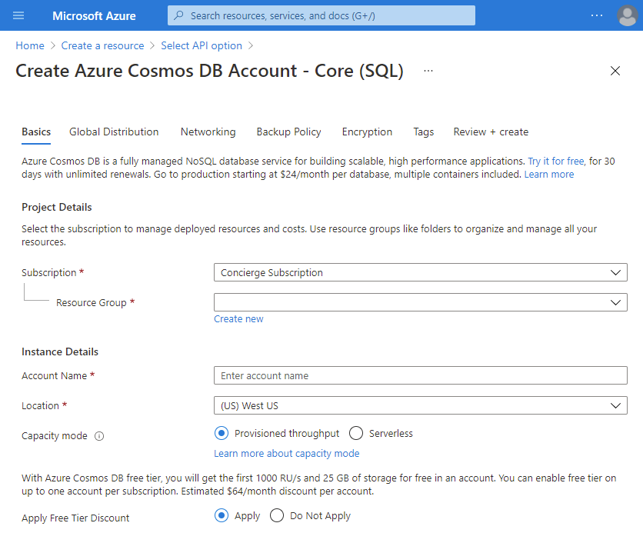
Resource Model - Creating an Account
Account
Database
Database
Database
Database
Database
Container
Database
Database
Item
Notes:
The Azure Portal will use a step-by-step wizard with tabs for various configuration options
Only the options in the Basics tab are required to create an Azure Cosmos DB account
Here you can configure options such as:
The globally unique name of your account
The location (Azure region) for the account
Capacity mode (provisioned throughput or serverless)

Slide 7
Resource Model - Database Resources
Account
Database
Database
Database
Container
Container
Database
Database
Database
Database
Item
Item
Notes:
A database is a logical unit of management for containers in Azure Cosmos DB SQL API
An Azure Cosmos DB database manages users, permissions and containers
Within the database, you can find one or more containers

Slide 8
Resource Model - Containers
Account
Database
Database
Database
Database
Database
Container
Database
Database
Item
Notes:
Containers are the fundamental unit of scalability in Azure Cosmos DB SQL API
With Azure Cosmos DB, you provision throughput at the container level
You can also optionally configure an indexing policy or a default time-to-live value at the container level
Azure Cosmos DB SQL API will automatically and transparently partition the data in a container.

Slide 9
Resource Model - Container Level Resources
Account
Database
Database
Database
Database
Database
Container
Database
Database
Sproc
Trigger
UDF
Conflict
Item
Notes:
A Cosmos DB resource container is a schema-agnostic container of arbitrary user-generated JSON items
Containers can also store JavaScript based stored procedures, triggers and user-defined-functions (UDFs)
The SQL API for Azure Cosmos DB stores individual documents in JSON format as items within the container
Azure Cosmos DB SQL API natively supports JSON files and can provide fast and predictable performance because write operations on JSON documents are atomic

Slide 10

{
"id": "0012D555-C7DE",
"type": "customer",
"fullName": "Franklin Ye",
"title": null,
"emailAddress": "fye@cosmic.works",
"creationDate": "2014-02-05",
"addresses": [
{
"addressLine": "1796 Westbury Drive",
"cityStateZip": "Melton, VIC 3337 AU"
},
{
"addressLine": "9505 Hargate Court",
"Zip": "Bellflower, CA 90706 US"
}
],
"password": {
"hash": "GQF7qjEgMk=",
"salt": "12C0F5A5"
},
"salesOrderCount": 2
}
Items = JSON Documents
Open standard document format
Language-independent data format
Made up of attribute–value pairs
Supports recursive embedding
Supports embedded arrays
Flexible schema
Notes:
JavaScript Object Notation (JSON) is an open standard file format, and data interchange format, that uses human-readable text to store and transmit data objects consisting of attribute–value pairs and array data types (or any other serializable value)
It is a very common data format, with a diverse range of applications, such as serving as a replacement for XML in AJAX systems
JSON is a language-independent data format
It was derived from JavaScript, but many modern programming languages include code to generate and parse JSON-format data
The official Internet media type for JSON is application/json
JSON filenames use the extension .json
Douglas Crockford originally specified the JSON format in the early 2000s
JSON was first standardized in 2013

Slide 11
{
"id": "0012D555-C7DE",
"type": "customer",
"fullName": "Franklin Ye",
"title": null,
"emailAddress": "fye@cosmic.works",
"creationDate": "2014-02-05",
"addresses": [
{
"addressLine": "1796 Westbury Drive",
"cityStateZip": "Melton, VIC 3337 AU"
},
{
"addressLine": "9505 Hargate Court",
"Zip": "Bellflower, CA 90706 US"
}
],
"password": {
"hash": "GQF7qjEgMk=",
"salt": "12C0F5A5"
},
"salesOrderCount": 2
}
string
Data Types
Supports simple values stored in common data types:
Strings
Integer numbers
Floating point numbers
Boolean
Null
number
Notes:
There are simple value types that you can store in JSON easily:
Strings to represent arbitrary text
Integers for positive or negative whole numbers
Floating points for numbers with a decimal point
Booleans for true/false values
Null special value when no value is assigned
JSON does not support a native date type

Slide 12
{
"id": "0012D555-C7DE",
"type": "customer",
"fullName": "Franklin Ye",
"title": null,
"emailAddress": "fye@cosmic.works",
"creationDate": "2014-02-05",
"addresses": [
{
"addressLine": "1796 Westbury Drive",
"cityStateZip": "Melton, VIC 3337 AU"
},
{
"addressLine": "9505 Hargate Court",
"Zip": "Bellflower, CA 90706 US"
}
],
"password": {
"hash": "GQF7qjEgMk=",
"salt": "12C0F5A5"
},
"salesOrderCount": 2
}
Objects
Dictionary of key-value pairs
Surrounded by curly braces
Can be embedded within each other for complex domain representation
object
Notes:
Object literals are combinations of key-value pairs surrounded by curly braces
Technically, the overall JSON document is an object literal
The value for any key/property can also be another object literal making it possible to embed multiple documents
Embedded object literals are useful for modeling 1:1 relationships

Slide 13
{
"id": "0012D555-C7DE",
"type": "customer",
"fullName": "Franklin Ye",
"title": null,
"emailAddress": "fye@cosmic.works",
"creationDate": "2014-02-05",
"addresses": [
{
"addressLine": "1796 Westbury Drive",
"cityStateZip": "Melton, VIC 3337 AU"
},
{
"addressLine": "9505 Hargate Court",
"Zip": "Bellflower, CA 90706 US"
}
],
"password": {
"hash": "GQF7qjEgMk=",
"salt": "12C0F5A5"
},
"salesOrderCount": 2
}
Arrays
Set of multiple JSON object literals
Useful for child objects that are unpredictable in quantity
array
Notes:
Arrays work almost exactly how they work in JavaScript
Arrays are useful for modeling 1:∞ relationships

Slide 14
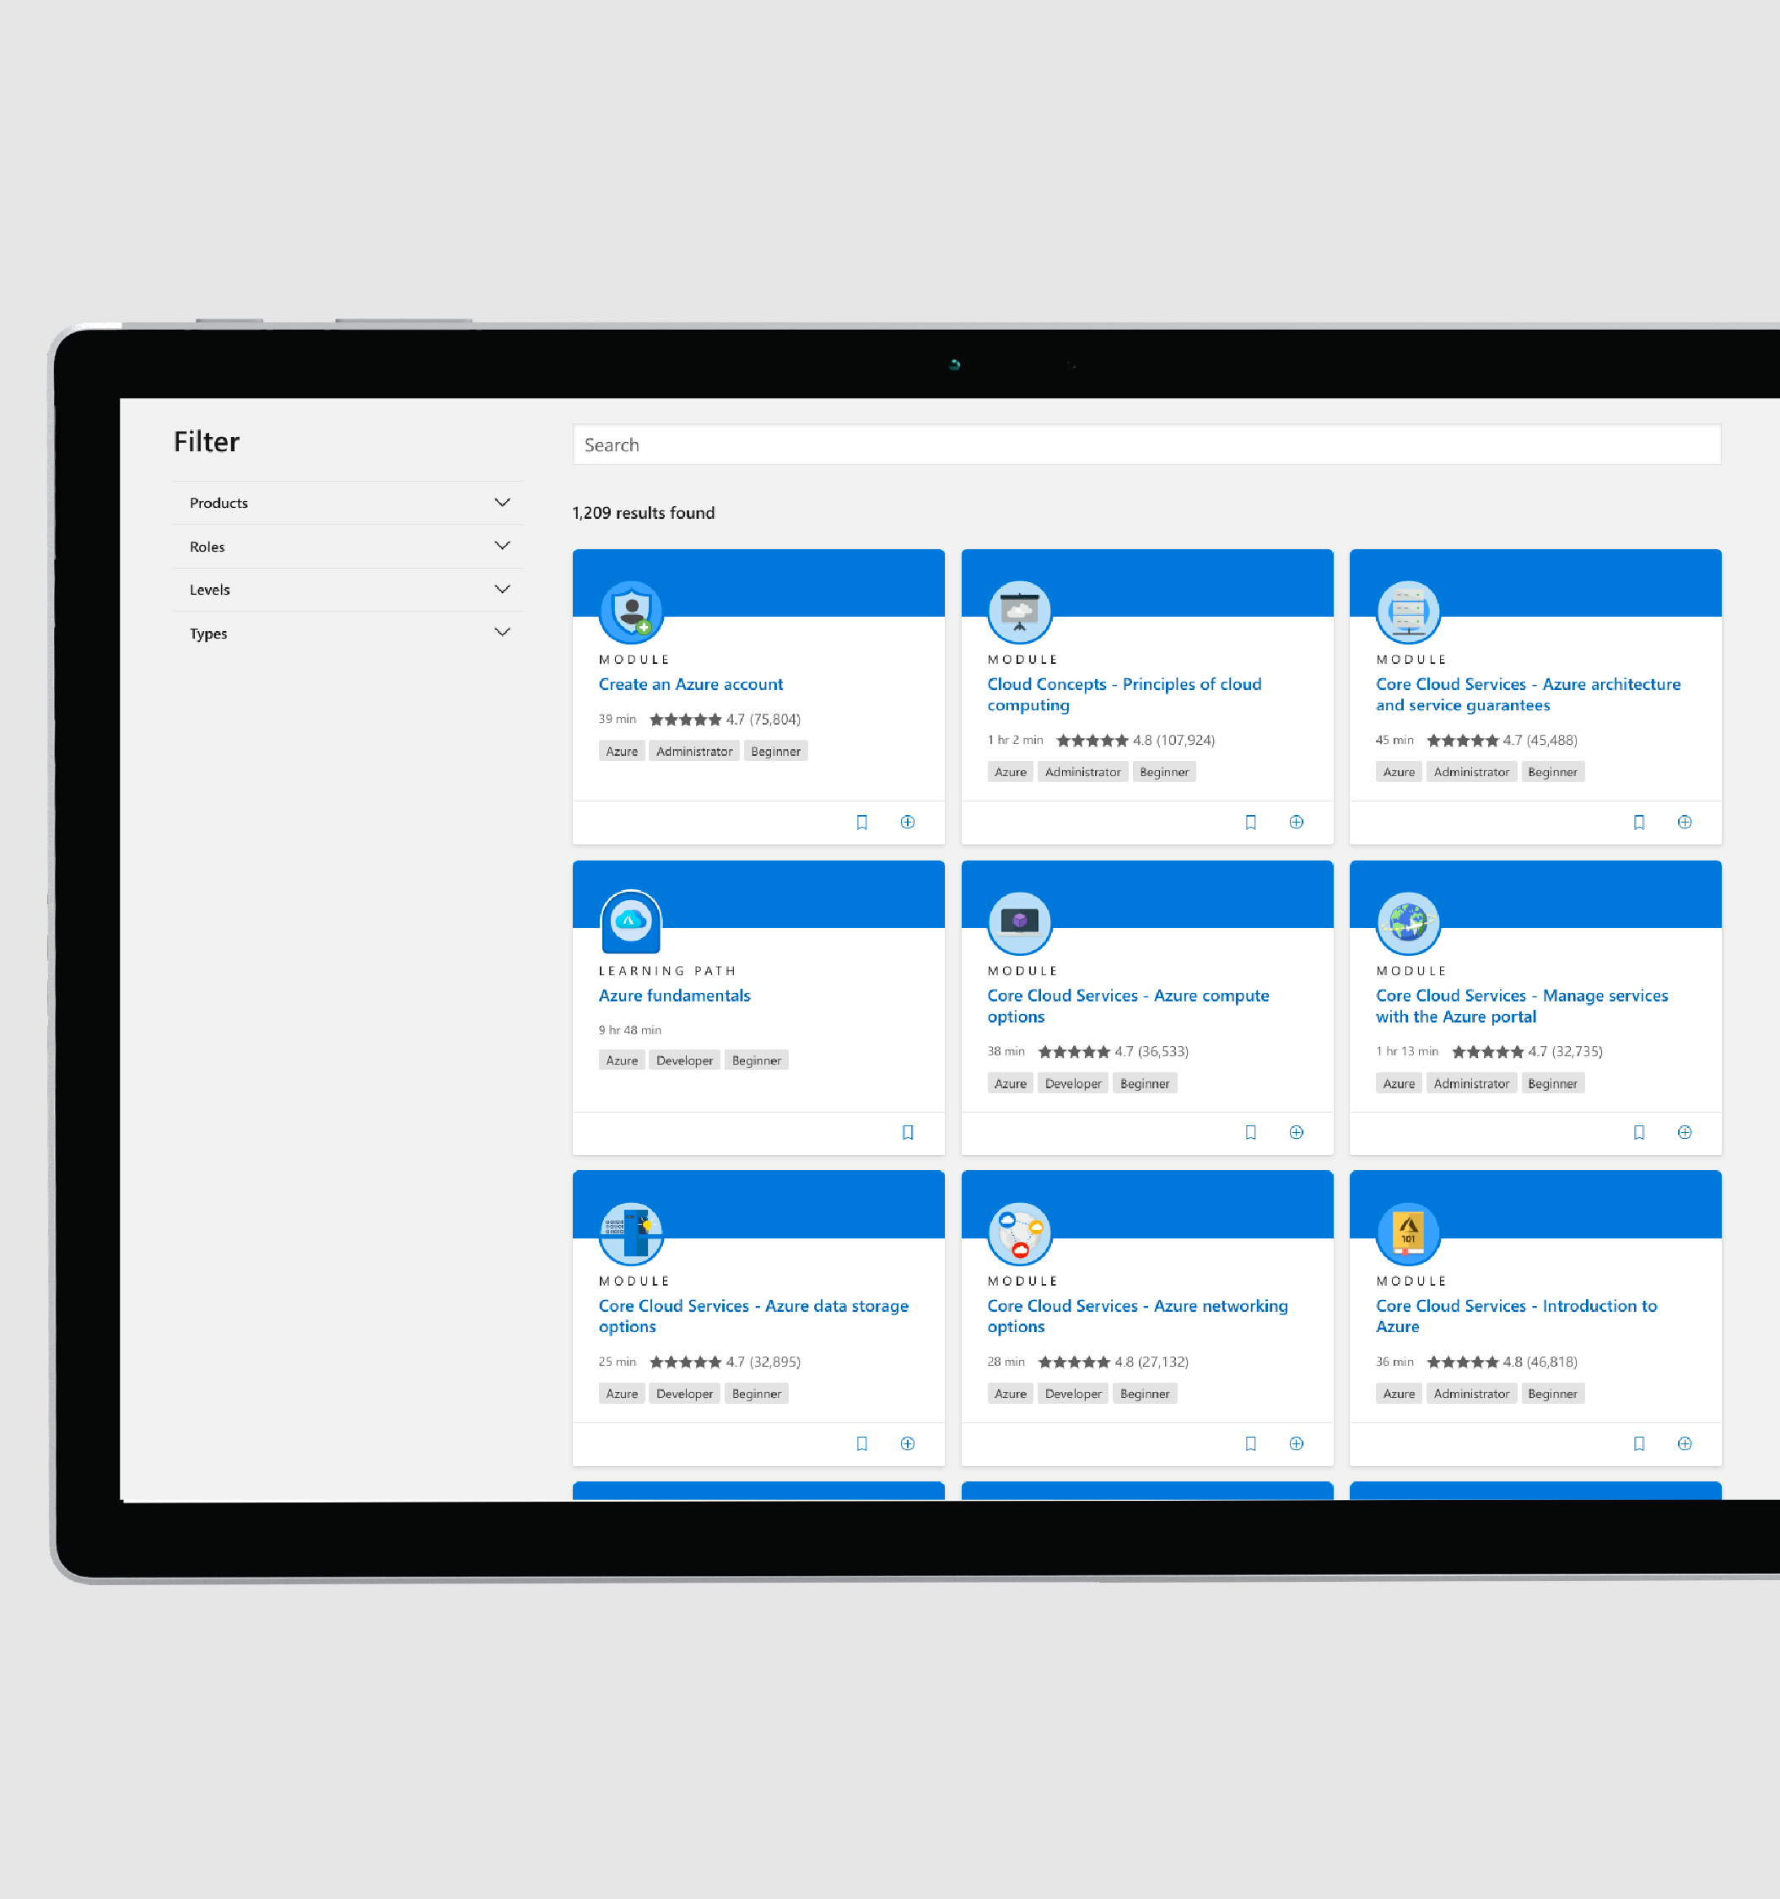
Keep on with Microsoft Learn
Review an interactive course with hands-on exercises, videos, and knowledge checks
Try Azure Cosmos DB Core API @ docs.com/learn

Slide 15


Throughput
RU
Dynamically provisioning the right amount of throughput for your application workloads
% Memory
% CPU
% IOPS

Slide 16
Request Units
RU
Rate-based currency
Abstraction over physical resources
Key to:
Multi-tenancy
SLAs
Cost efficiency
Covers foreground and background activities
% Memory
% CPU
% IOPS
Notes:
Request Units (RUs) is a rate-based currency
Abstracts physical resources for performing requests
Key to multi-tenancy, SLAs, and cost efficiency
Covers foreground and background activities

Slide 17
Request Units
RU
Normalized across various access methods
1 RU = 1 read of 1 KB item
Each request consumes fixed RUs
Applies to reads, writes, query, and stored procedures
Read
1 RU
Insert
Update
Delete
Query
Variable number of RUs
Notes:
Each request consumes # of RU
Approx. 1 RU = 1 read of 1 KB document
Approx. 5 RU = 1 write of a 1KB document
RUs for queries depends on query & documents involved

Slide 18

Request Units – Capacity Mode
Account
Provisioned throughput
Serverless
Database
Database
Database
4,000 RU/s
4,000 RU/s
Database
Database
Container
2,500 RU/s
Database
Database
Item

Slide 19

Provisioned Throughput
Provisioned in terms of RU/sec
Rate limiting
Increase or decrease instantaneously
Metered hourly
Background processes scheduled when quiescent
Rate limit
Max RU/sec
Incoming Requests
No rate limiting
Min RU/sec
Replica Quiescent
Provisioned throughput
Serverless
Notes:
Provisioned in terms of RU/sec
Rate limiting based on amount of throughput provisioned
Can be increased or decreased instantaneously in most cases
Metered Hourly
Background processes like TTL expiration, index transformations scheduled when quiescent

Slide 20


Manual Provisioned Throughput
4,000 RU/s
Guaranteed throughput
Guaranteed low latency
Guaranteed availability
Notes:
This offer lets you configure the amount of throughput you expect the database to deliver, and requires you to plan ahead for the right performance level to cover your application’s needs.
Click-through:
Note that this offer delivers throughput
expressed in request units per second
So, by configuring my database at 4,000 RU per second, I’m guaranteed that this amount of throughput will be available, which is great for applications that receive sustained traffic
I also get very strong guarantees over the latency and availability of my database

Slide 21
Manual Provisioned Throughput
4,000 RU/s
unused capacity
Notes:
Click-through (continued):
Now it’s pretty rare that request traffic is as steady as shown here, and application traffic often varies over time
This can lead to unused capacity if the amount of throughput we have provisioned is substantially higher than the throughput your application consumes.

Slide 22

Manual Provisioned Throughput
4,000 RU/s
4,000 RU/s
2,500 RU/s
Notes:
Click-through (continued):
So when traffic patterns are predictable, Azure Cosmos DB lets you manually change the amount of provisioned throughput to make sure that the capacity you provision matches the capacity you need, either through the portal, writing an automation script, or programmatically in your code.

Slide 23
Autoscale Provisioned Throughput
? RU/s
Notes:
Click-through (continued):
What if my traffic patterns are unpredictable?
In this situation, it’s impractical, or even impossible to use manual scaling because we never know when we will need more throughput, and when we will need less

Slide 24
Autoscale Provisioned Throughput
4,000 RU/s
Notes:
Click-through (continued):
That’s when autoscale comes into play!
In this mode, you only have to configure a maximum amount of throughput you expect your application to need

Slide 25
Autoscale Provisioned Throughput
4,000 RU/s
Notes:
Click-through (continued):
Azure Cosmos DB will then automatically scale your provisioned throughput up and down to accommodate your application’s requirements within a range than spans from the maximum level you’ve configured, down to 10 percent of that maximum

Slide 26


Autoscale Provisioned Throughput
Max = 4,000 RU/s
Guaranteed throughput
Guaranteed low latency
Guaranteed availability
400 RU/s
10%
Notes:
Click-through (continued):
Autoscale delivers on the exact same promises
It is the best solution when you have unpredictable traffic patterns, but also need guaranteed performance

Slide 27
Database Level Throughput Provisioning
Account
10000 RU/s
Database
Database
Database
Container
Container
Container
Notes:
When you provision throughput on an Azure Cosmos database, the throughput is shared across all the containers (called shared database containers) in the database
An exception is if you specified a provisioned throughput on specific containers in the database (more on this later)
Sharing the database-level provisioned throughput among its containers is analogous to hosting a database on a cluster of machines
Because all containers within a database share the resources available on a machine, you naturally do not get predictable performance on any specific container

Slide 28
Container Level Throughput Provisioning
Account
Database
Database
1000 RU/s
4000 RU/s
2000 RU/s
Database
Container
Container
Container
Notes:
The throughput provisioned on an Azure Cosmos container is exclusively reserved for that container
The container receives the provisioned throughput all the time
The provisioned throughput on a container is financially backed by SLAs

Slide 29
Throughput Provisioning - Mixed
Account
6000 RU/s
Database
Database
2000 RU/s
Database
Container
Container
Container
Notes:
You can combine provisioning throughput and the database and container level
A container with provisioned throughput cannot be converted to shared database container
Conversely a shared database container cannot be converted to have a dedicated throughput

Slide 30
Serverless Capacity Mode
RU
No need to provision throughput
Pay for each and every transaction based on actual RU consumed
Maximum throughput: 5000 RU/s
Maximum storage: 20GB
RU
RU
RU
RU
RU
RU
RU
RU
Notes:
Serverless is a consumption-based model where you are only charged for the Request Units consumed by your database operations and the storage consumed by your data
Serverless containers can serve thousands of requests per second with no minimum charge and no capacity planning required
Serverless is ideal for applications where:
Traffic is bursty, hard to forecast, and/or intermittent
Applications have low overall traffic (dev/test/prototype/etc)
Applications have low (<`10%) average-to-peak traffic ratio

Slide 31
Serverless Capacity Mode
Notes:
Click-through:
When performing development or testing activities or even when running small, non-critical applications, our database may just sit idle most of the time, and only needs to process requests occasionally

Slide 32
Serverless Capacity Mode
If Autoscale provisioned throughput
Notes:
Click-through (continued):
We can certainly use autoscale here again a as it will dynamically scale up the delivered throughput whenever a request kicks in.

Slide 33
Serverless Capacity Mode
If Autoscale provisioned throughput
1 hour
unused capacity
10%
Notes:
Click-through (continued):
Butt because the billing granularity of autoscale is one hour,
and because it always provisions at least 10 percent of the maximum throughput you’ve configured,
this would still represent unused capacity.

Slide 34
Serverless Capacity Mode
RU
RU
RU
RU
RU
RU
RU
RU
RU
Notes:
Click-through (continued):
To best accommodate this kind of workload, we are introducing has the serverless offering
Azure Cosmos DB serverless is a pure consumption model where only Request Units consumed by each application request will get billed,
This eliminates the need for provisioned capacity concept, Request Units per second, from this scenario.

Slide 35
Request Units – Measuring RU Charges
Analyze Query Complexity
Measure Query Cost
Count indexed terms
Query complexity directly impacts RUs Predicates, functions, and index matches influence query cost
Headers:
x-ms-request-charge
SDK property: RequestCharge
Write operations runs the indexer Quantity of indexed terms influence RU charge Tune indexing policy
Notes:
Analyze Query Complexity
The complexity of a query impacts how many Request Units are consumed for an operation
The number of predicates, nature of the predicates, number of system functions, and the number of index matches / query results all influence the cost of query operations
Measure Query Cost
To measure the cost of any operation (create, update, or delete):
Inspect the x-ms-request-charge header
Inspect the RequestCharge property in ResourceResponse or FeedResponse in the SDK
Number of indexed terms
Every write operation will require the indexer to run
The more indexed terms you have, the more indexing will be directly having an effect on the RU charge
You can optimize for this by fine-tuning your index policy to include only fields and/or paths certain to be used in queries

Slide 36
Keep on with Microsoft Learn
Review an interactive course with hands-on exercises, videos, and knowledge checks
Model and partition your data in Azure Cosmos DB @ docs.com/learn

